Slide 1
3D Model Sorter
Based on Geometrical Information
Mayur Kapadnis

Slide 2
Introduction
Project Overview: Creation of a graphical 3D model sorter project based on geometrical information. Developed using the Qt framework and OpenGL library with C++.
Input Format: The project takes STL files as input.
Output Format: Users can select multiple STL files and sorting criteria. Hit the "Sort" button to display STL objects in a sorted form.
Key Features: Utilizes Qt for the user interface. OpenGL library for 3D graphics rendering. Dynamic sorting based on user-selected criteria.

Slide 3
Project Workflow
User Interface: The user interface is designed using the Qt framework for a user-friendly experience.
Input Processing: The project accepts STL files, a widely used format for representing 3D models. Users can select multiple STL files in the input window.
Sorting Criteria: Users can choose sorting criteria such as height, cost etc.
Sorting Process: Upon hitting the "Sort" button, the sorting algorithm processes the selected STL
files based on the chosen criteria. The sorted models are displayed in the output window.
Visual Display: Utilizes the OpenGL library for rendering 3D models in the output window.

Slide 4
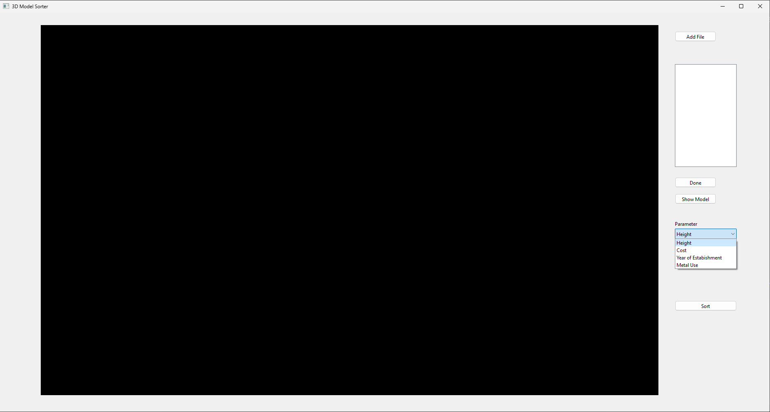
UI

Slide 5

Video

Slide 6
Thanks

